Slide 1

GPU Architecture Overview
Patrick Cozzi
University of Pennsylvania
CIS 565 - Fall 2013

Slide 2
Reminders
Course website
http://www.seas.upenn.edu/~cis565/
Google Group
Signup: https://groups.google.com/forum/#!forum/cis-565-fall-2013
GitHub
Create an account: https://github.com/signup/free
Change it to an edu account: https://github.com/edu

Slide 3
Projects
Project 0 due Monday 09/09
Project 1
Released Monday 09/09
Due Wednesday 09/18
In-class demos Wednesday 09/18

Slide 4
Today
Walkthrough Project 0
CPU and GPU architecture

Slide 5
Course Overview Follow-Up
Progress – students surpass teaches
I want more than 2% impact

Slide 6
Acknowledgements
CPU slides – Varun Sampath, NVIDIA
GPU slides
Kayvon Fatahalian, CMU
Mike Houston, AMD

Slide 7
CPU and GPU Trends
FLOPS – FLoating-point OPerations per Second
GFLOPS - One billion (10⁹) FLOPS
TFLOPS – 1,000 GFLOPS
Notes:
FLOPS are not a perfect measurement because of memory access, instruction mix, branches, etc. Peak FLOPS are idealistic, but not often reached in practice.

Slide 8
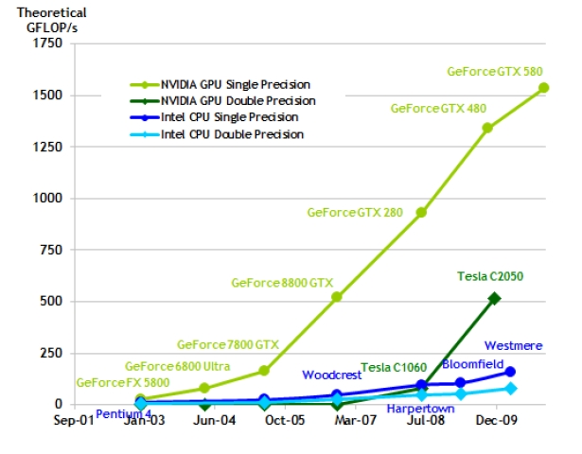
CPU and GPU Trends
Chart from: http://proteneer.com/blog/?p=263
Notes:
Moore’s Law – the number of transistors on a chip will double about every two year

Slide 9
CPU and GPU Trends
Compute
Intel Core i7 – 4 cores – 100 GFLOP
NVIDIA GTX280 – 240 cores – 1 TFLOP
Memory Bandwidth
System Memory – 60 GB/s
NVIDIA GTX680 – 200 GB/s
PCI-E Gen3 – 8 GB/s
Install Base
Over 400 million CUDA-capable GPUs
Notes:
PCI-E Gen3 is 8 GB/s in each direction

Slide 10
CPU and GPU Trends
Single-core performance slowing since 2003
Power and heat limits
GPUs delivery higher FLOP per
Watt
Dollar
Mm
2012 – GPU peak FLOP about 10x CPU

Slide 11
CPU Review
What are the major components in a CPU die?
Notes:
Cache, branch predicator, out-of-order logic, ALUs, …

Slide 12
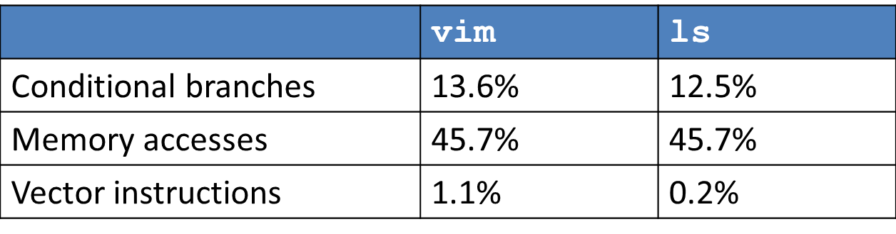
CPU Review
Desktop Applications
Lightly threaded
Lots of branches
Lots of memory accesses
Profiled with psrun on ENIAC
Slide from Varun Sampath
Notes:
Software likes “serial,” hardware likes “parallel.”
Branch prediction accuracy
96.7% - vim
98.9% - ls

Slide 13
A Simple CPU Core
+
4
PC
Register
File
I$
D$
s1
s2
d
control
Fetch → Decode → Execute → Memory → Writeback
Image: Penn CIS501
Notes:
Clocked. All of these steps occur in one clock period.
Clock period bound by datapath delay.
Bad utilization.

Slide 14
Pipelining
+
4
Register
File
PC
Insn
Mem
Data
Mem
s1
s2
d
T_{insn-mem}
T_{regfile}
T_{ALU}
T_{data-mem}
T_{regfile}
T_{singlecycle}
Image: Penn CIS501
Notes:
Capitalize on instruction-level parallelism (ILP)
+ Significantly reduced clock period
– Slight latency & area increase (pipeline latches)
? Dependent instructions
? Branches
Alleged Pipeline Lengths:
Core 2: 14 stages
Pentium 4 (Prescott): > 20 stages
Sandy Bridge: in between
Pipelining allows much higher clock speeds.
Pipeline length source: Agner Fog’s Microarchitecture Guide

Slide 15
Branches
IR
Register
File
A
B
IR
O
B
IR
O
D
IR
Data
Mem
a
s1
s2
d
d
S
X
F/D
D/X
X/M
M/W
nop
???
???
jeq loop
Image: Penn CIS501
Notes:
We don’t know what instructions will execute after the branch until the branch is executed. We could either stall until it is, or “speculate” and flush on a misprediction.

Slide 16
Branch Prediction
+ Modern predictors > 90% accuracy
Raise performance and energy efficiency (why?)
– Area increase
– Potential fetch stage latency increase
Notes:
96.7% accurate on vim example
Flushing a pipeline means a waste of all executed instructions. Area increase potentially even greater for tournament predictors.

Slide 17
Memory Hierarchy
Memory: the larger it gets, the slower it gets
Rough numbers:
 | Latency | Bandwidth | Size
SRAM (L1, L2, L3) | 1-2ns | 200GBps | 1-20MB
DRAM (memory) | 70ns | 20GBps | 1-20GB
Flash (disk) | 70-90µs | 200MBps | 100-1000GB
HDD (disk) | 10ms | 1-150MBps | 500-3000GB
Notes:
SRAM & DRAM latency, and DRAM bandwidth for Sandy Bridge from Lostcircuits
Flash and HDD latencies from AnandTech
Flash and HDD bandwidth from AnandTech Bench
SRAM bandwidth guesstimated.

Slide 18
Caching
Keep data weneed close
Exploit:
Temporal locality
Chunk just used likely to be used again soon
Spatial locality
Next chunk to use is likely close to previous

Slide 19
Cache Hierarchy
I$
D$
Hardware-managed
L1 Instruction/Data caches
L2 unified cache
L3 unified cache
Software-managed
Main memory
Disk
L2
Larger
Faster
L3
Main Memory
Disk
(not to scale)
Notes:
LRU-esque eviction algorithms used for caches. Could be inclusive, exclusive, or neither. OS manages virtual memory.

Slide 20
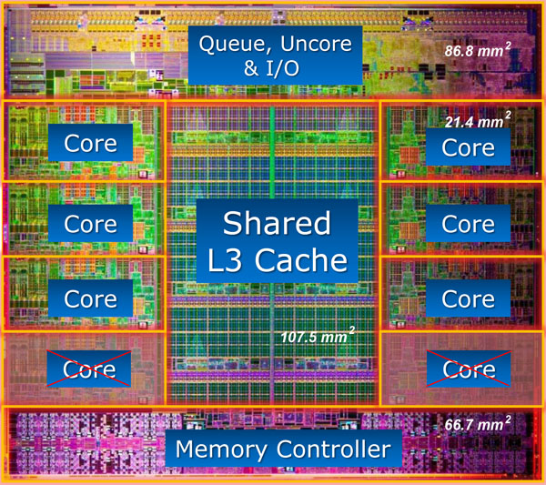
Intel Core i7 3960X – 15MB L3 (25% of die). 4-channel Memory Controller, 51.2GB/s total
^{Source: www.lostcircuits.com}
Notes:
Look at caches – 24.7% of die is L3 cache – 15MB
32KB I$ and 32KB D$
256KB L2 per core
Memory controller – 15% of die; 4 channels, each supporting DDR3-1600 → 12.8GB/s

Slide 21
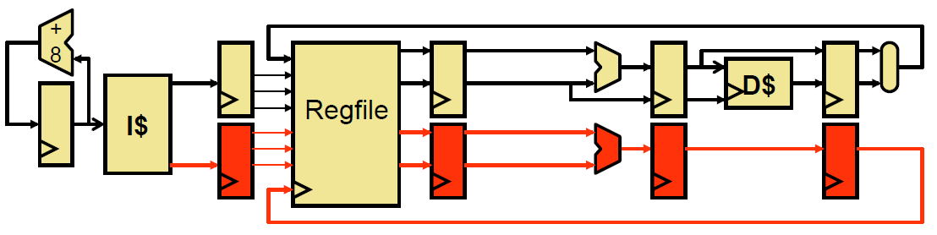
Improving IPC
IPC (instructions/cycle) bottlenecked at 1 instruction / clock
Superscalar – increase pipeline width
Image: Penn CIS371
Notes:
Duplicate pipeline registers, execution resources, ports

Slide 22
Scheduling
Consider instructions:
xor r1,r2 -> r3
add r3,r4 -> r4
sub r5,r2 -> r3
addi r3,1 -> r1
xor and add are dependent (Read-After-Write, RAW)
sub and addi are dependent (RAW)
xor and sub are not (Write-After-Write, WAW)

Slide 23
Register Renaming
How about this instead:
xor p1,p2 -> p6
add p6,p4 -> p7
sub p5,p2 -> p8
addi p8,1 -> p9
xor and sub can now execute in parallel

Slide 24
Out-of-Order Execution
Reordering instructions to maximize throughput
Fetch → Decode → Rename → Dispatch → Issue → Register-Read → Execute → Memory → Writeback → Commit
Reorder Buffer (ROB)
Keeps track of status for in-flight instructions
Physical Register File (PRF)
Issue Queue/Scheduler
Chooses next instruction(s) to execute
Notes:
New pipeline. 3 Principal data structures.

Slide 25
Parallelism in the CPU
Covered Instruction-Level (ILP) extraction
Superscalar
Out-of-order
Data-Level Parallelism (DLP)
Vectors
Thread-Level Parallelism (TLP)
Simultaneous Multithreading (SMT)
Multicore

Slide 26
Vectors Motivation
for (int i = 0; i < N; i++)
A[i] = B[i] + C[i];
Notes:
How do we make this go fast?

Slide 27
CPU Data-level Parallelism
Single Instruction Multiple Data (SIMD)
Let’s make the execution unit (ALU) really wide
Let’s make the registers really wide too
for (int i = 0; i < N; i+= 4) {
// in parallel
A[i] = B[i] + C[i];
A[i+1] = B[i+1] + C[i+1];
A[i+2] = B[i+2] + C[i+2];
A[i+3] = B[i+3] + C[i+3];
}

Slide 28
Vector Operations in x86
SSE2
4-wide packed float and packed integer instructions
Intel Pentium 4 onwards
AMD Athlon 64 onwards
AVX
8-wide packed float and packed integer instructions
Intel Sandy Bridge
AMD Bulldozer
Notes:
Sandy Bridge can issue 2 AVX ops per cycle

Slide 29
Thread-Level Parallelism
Thread Composition
Instruction streams
Private PC, registers, stack
Shared globals, heap
Created and destroyed by programmer
Scheduled by programmer or by OS

Slide 30
Simultaneous Multithreading
Instructions can be issued from multiple threads
Requires partitioning of ROB, other buffers
+ Minimal hardware duplication
+ More scheduling freedom for OoO
– Cache and execution resource contention can reduce single-threaded performance
Notes:
Register state, return stack buffer, and large page ITLB only replicated stuff: http://www.anandtech.com/show/2594/8

Slide 31
Multicore
Replicate full pipeline
Sandy Bridge-E: 6 cores
+ Full cores, no resource sharing other than last-level cache
+ Easier way to take advantage of Moore’s Law
– Utilization

Slide 32
CPU Conclusions
CPU optimized for sequential programming
Pipelines, branch prediction, superscalar, OoO
Reduce execution time with high clock speeds and high utilization
Slow memory is a constant problem
Parallelism
Sandy Bridge-E great for 6-12 active threads
How about 12,000?
Notes:
A lot of effort put into improving IPC, and avoiding memory latencies. Attacking throughput is an entirely different game.

Slide 33
How did this happen?
http://proteneer.com/blog/?p=263
Notes:
Can’t achieve this because real code has branches, memory access, different instruction mixes, and doesn’t have 100% occupancy.

Slide 34
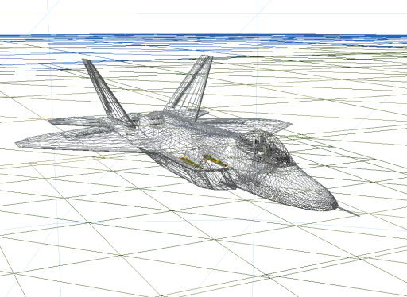


Graphics Workloads
Triangles/vertices and pixels/fragments
Right image from http://http.developer.nvidia.com/GPUGems3/gpugems3_ch14.html

Slide 35
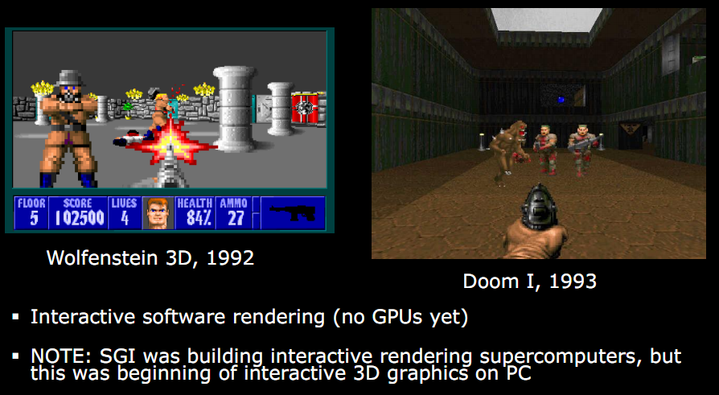
Early 90s – Pre GPU
Slide from http://s09.idav.ucdavis.edu/talks/01-BPS-SIGGRAPH09-mhouston.pdf
Notes:
Wolf 3D – 2.5D. No ceiling and floor height changes (or textures). No rolling walls. No lighting. Enemies always face viewer. Ray casting. Pre-computed texture coordinates.
Doom – Based on BSP tree (Bruce Naylor). Texture mapped all surfaces. Lighting. Varying floor altitudes. Rolling walls.

Slide 36
Why GPUs?
Graphics workloads are embarrassingly parallel
Data-parallel
Pipeline-parallel
CPU and GPU execute in parallel
Hardware: texture filtering, rasterization, etc.

Slide 37
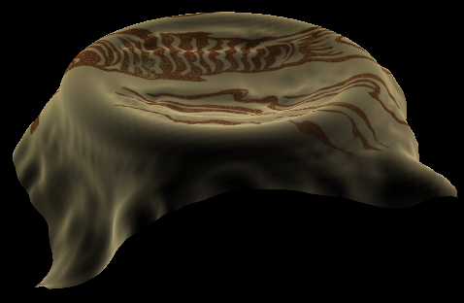
Data Parallel
Beyond Graphics
Cloth simulation
Particle system
Matrix multiply
Image from: https://plus.google.com/u/0/photos/100838748547881402137/albums/5407605084626995217/5581900335460078306
Notes:
Data Parallel – The same program running on multiple data (SPMD).
Cloth is modeled with a mass-spring-damper system obeying Hook’s Law. The force on each mass is computed independently at each time step.
Each particle in a particle system has forces like gravity and wind. Integrating from f = ma to position can be done independently at each time step.
Can an application have more than one type of parallelism?

Slide 38
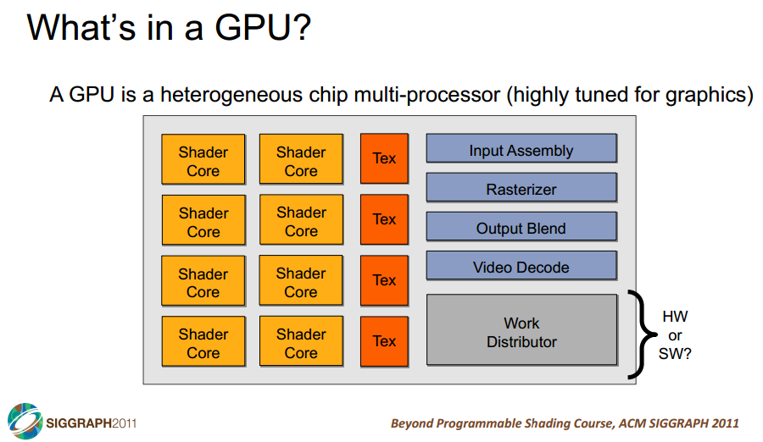

Slide 39
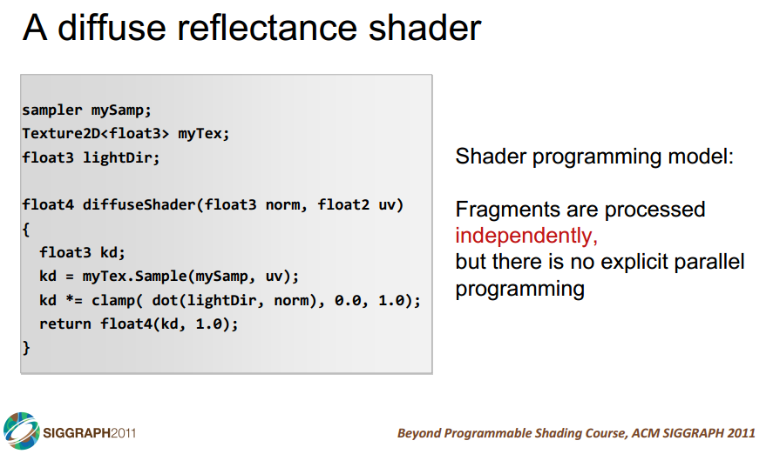

Slide 40
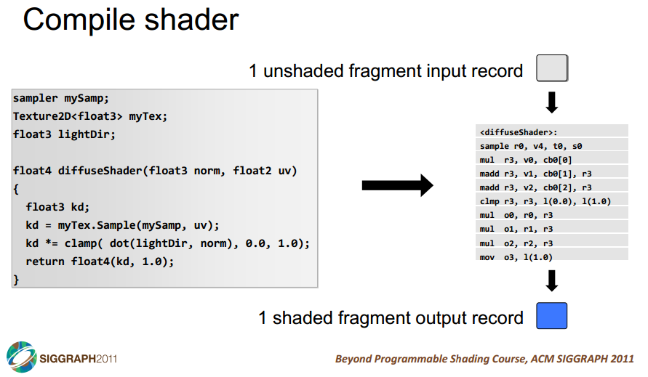

Slide 41
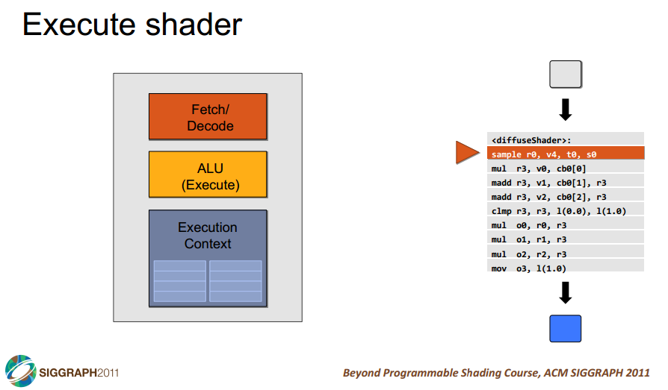

Slide 42
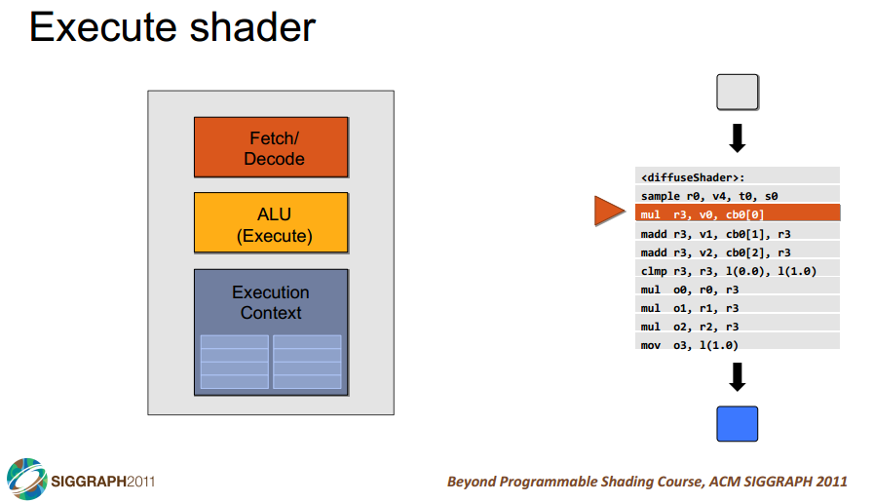

Slide 43
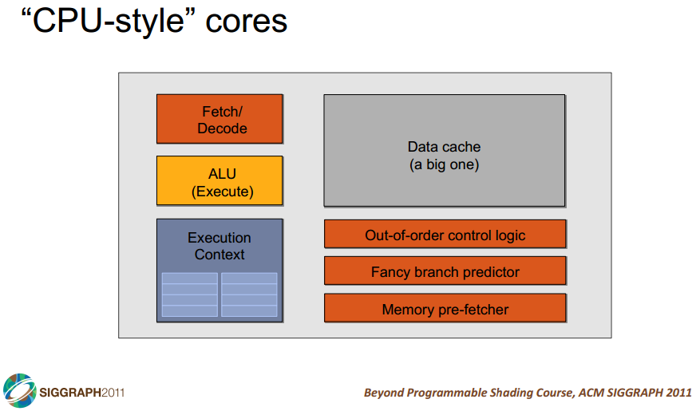

Slide 44
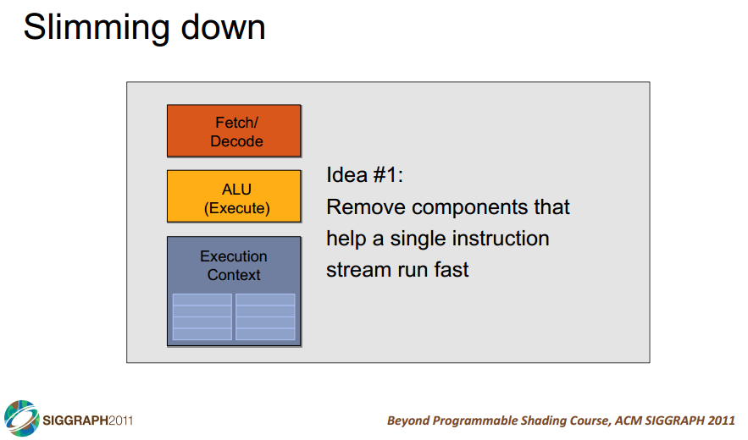

Slide 45
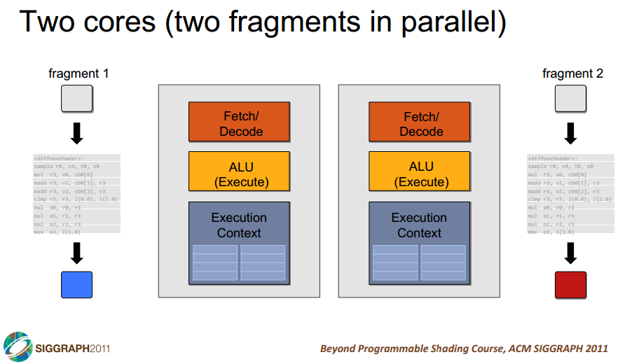

Slide 46
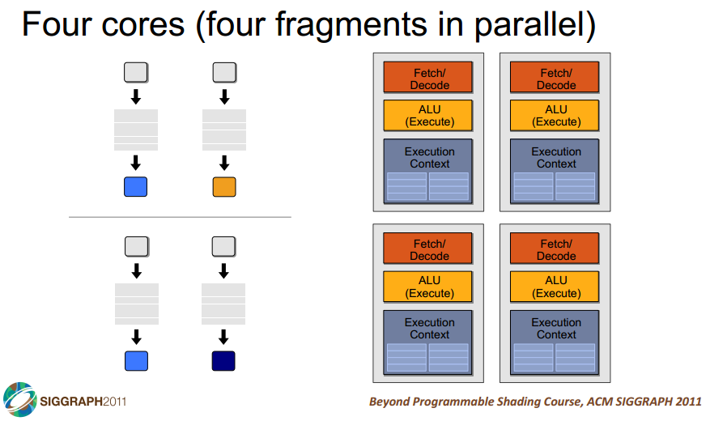

Slide 47
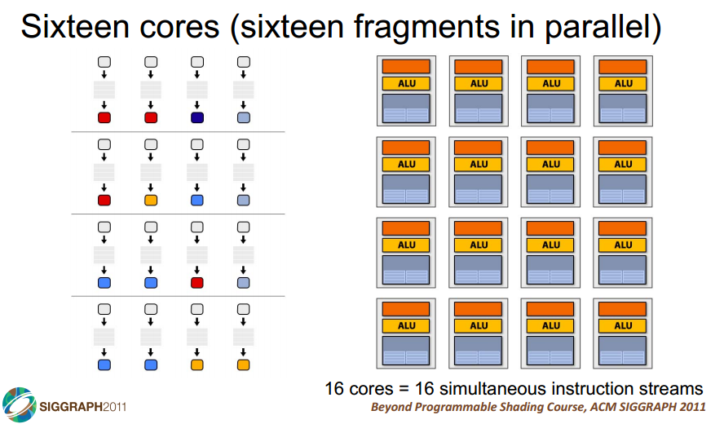

Slide 48
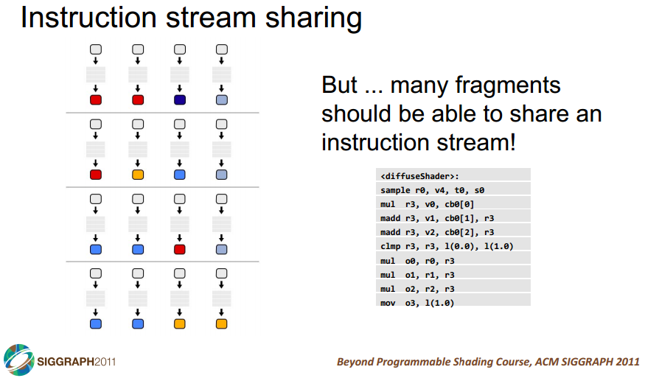

Slide 49
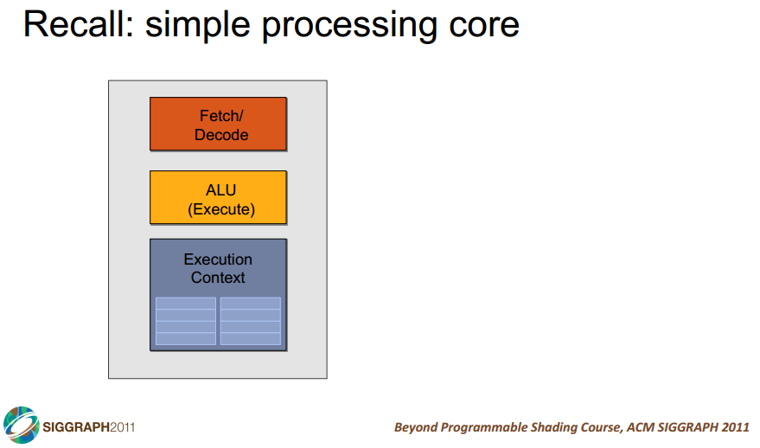

Slide 50
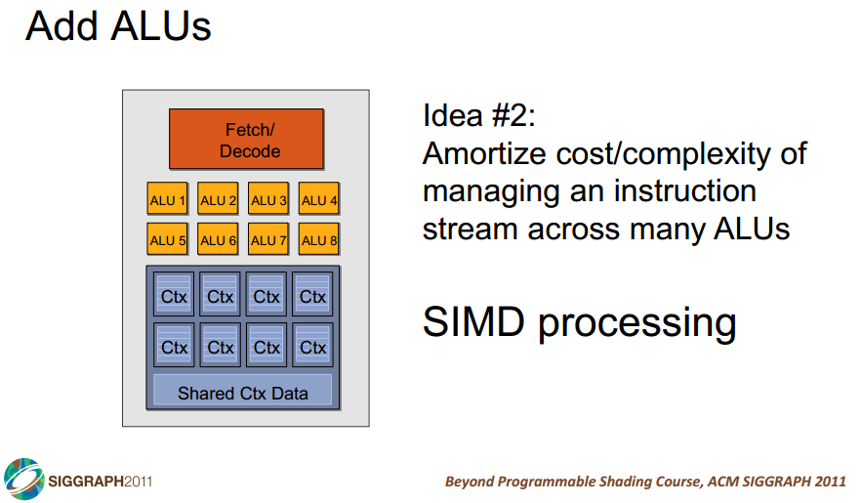

Slide 51
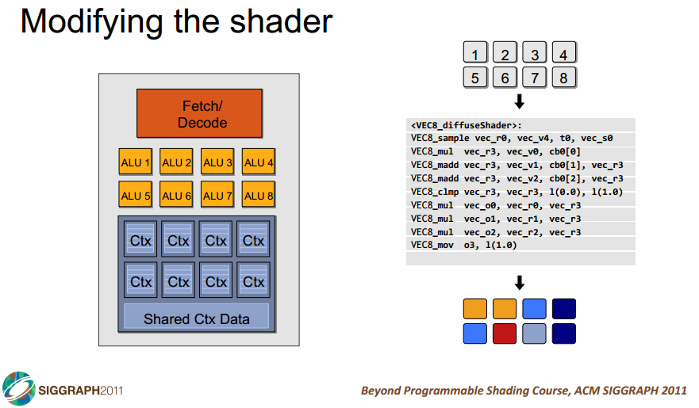

Slide 52
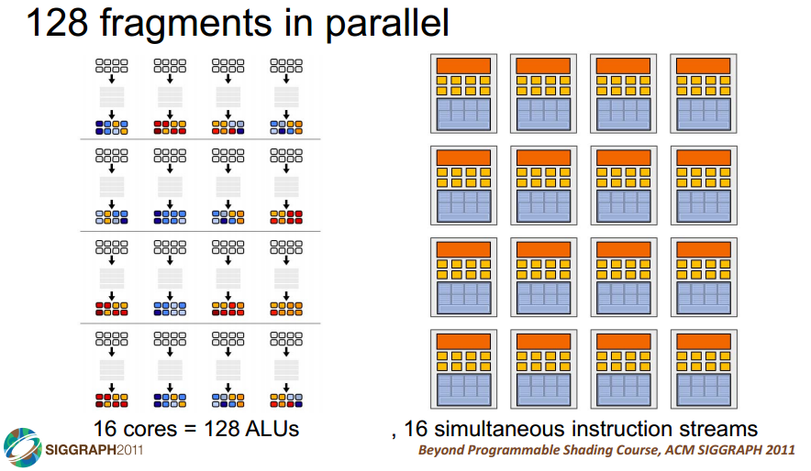

Slide 53
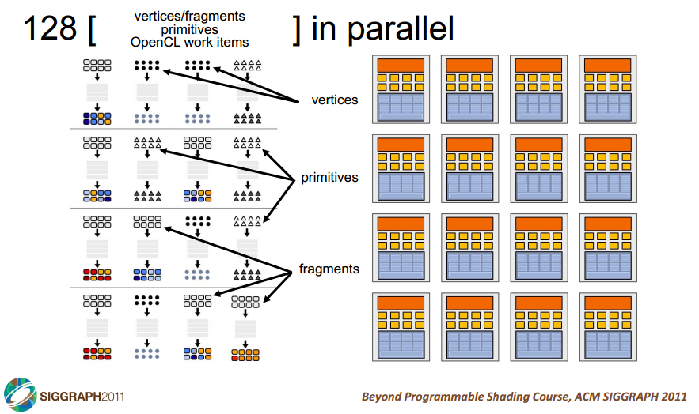

Slide 54
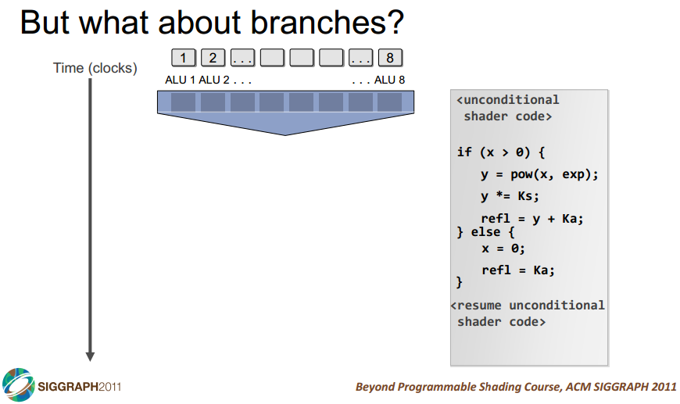

Slide 55
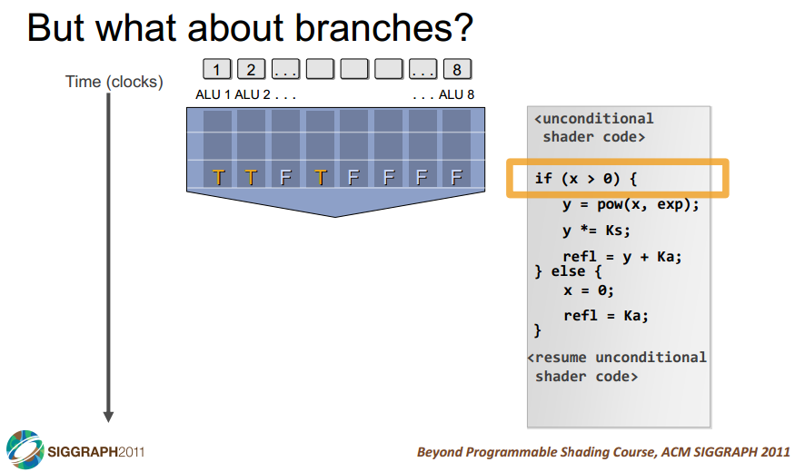

Slide 56
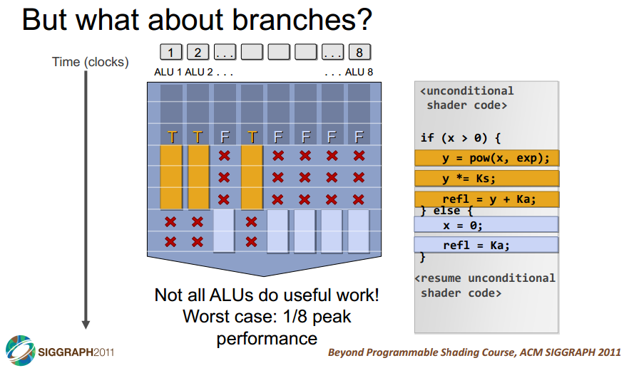

Slide 57
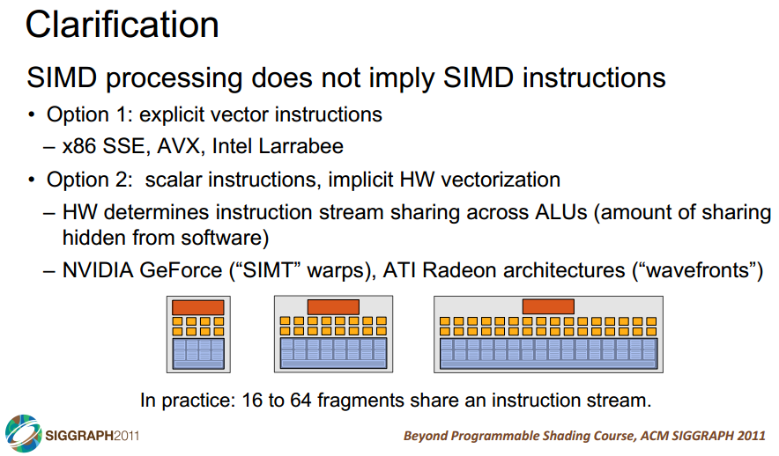

Slide 58
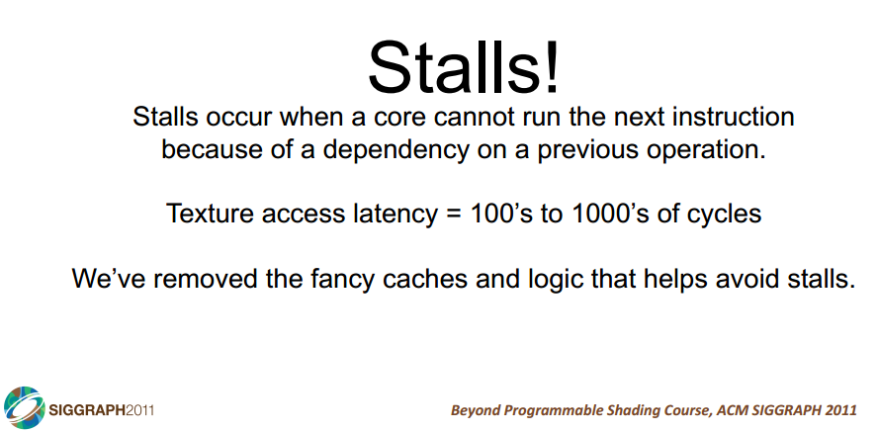

Slide 59
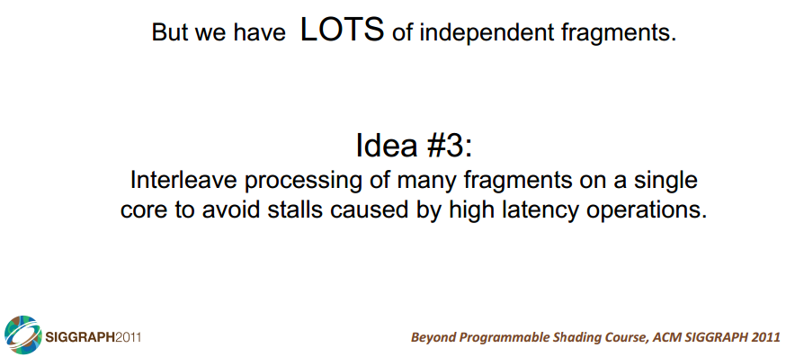

Slide 60
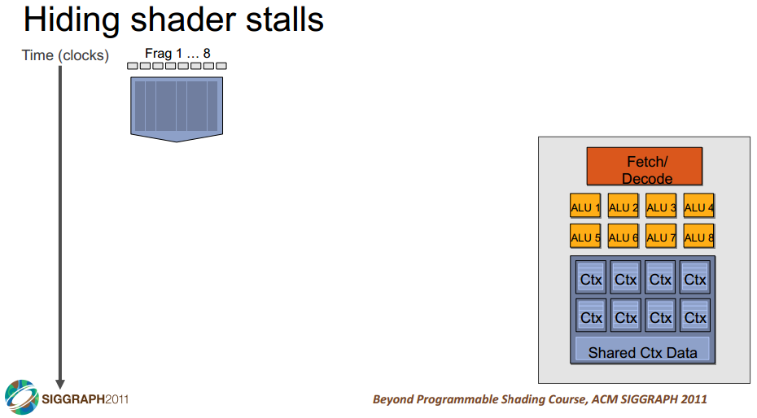

Slide 61
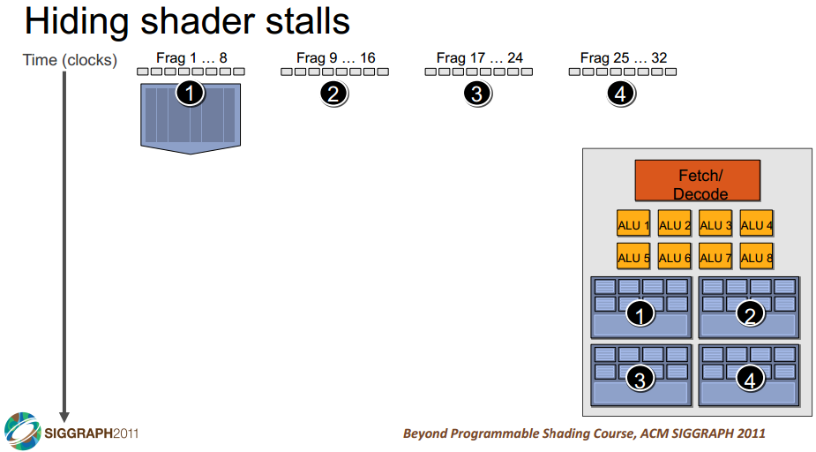

Slide 62
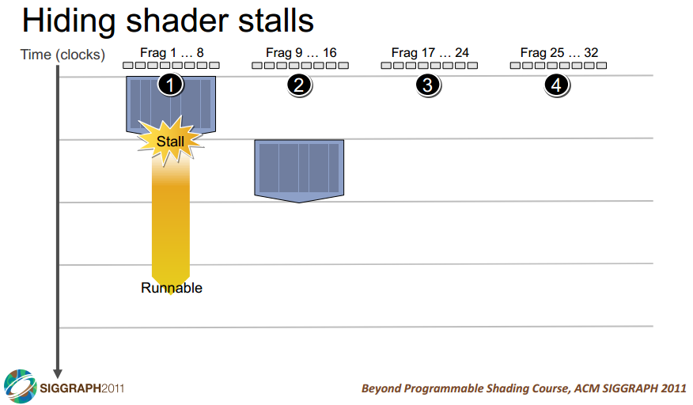

Slide 63
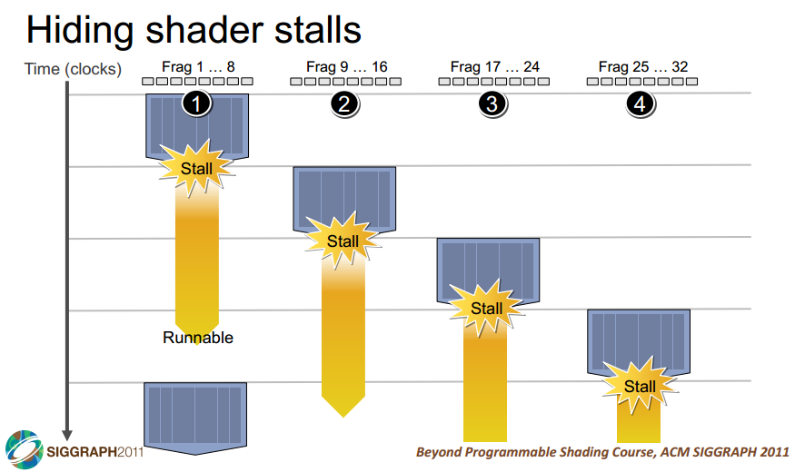

Slide 64
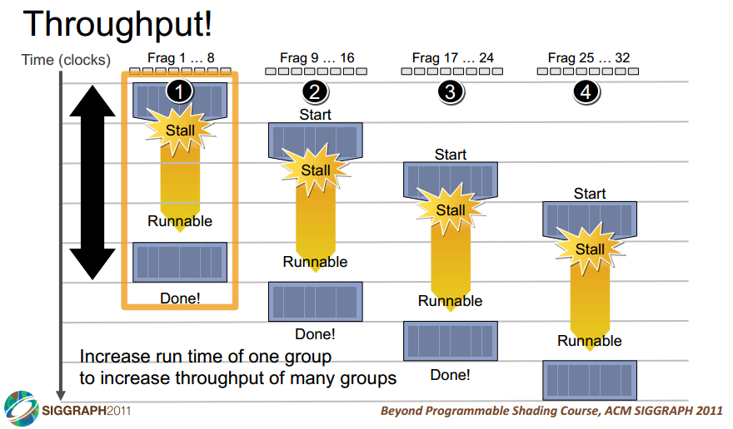

Slide 65
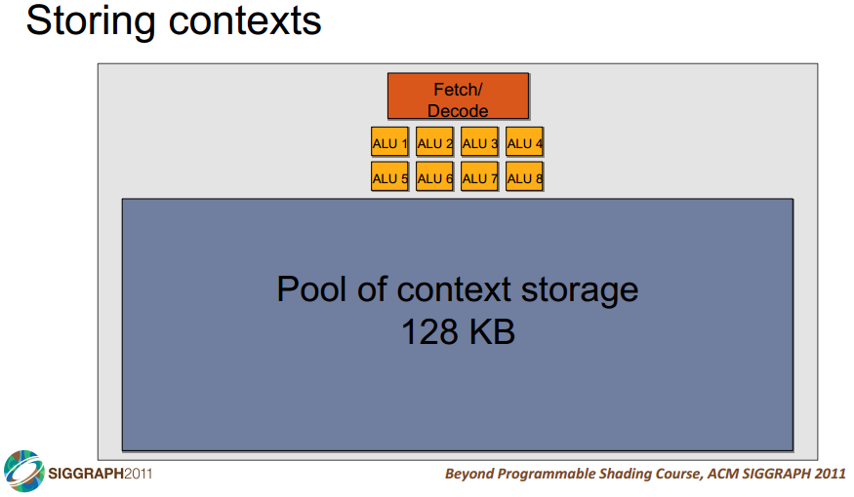

Slide 66
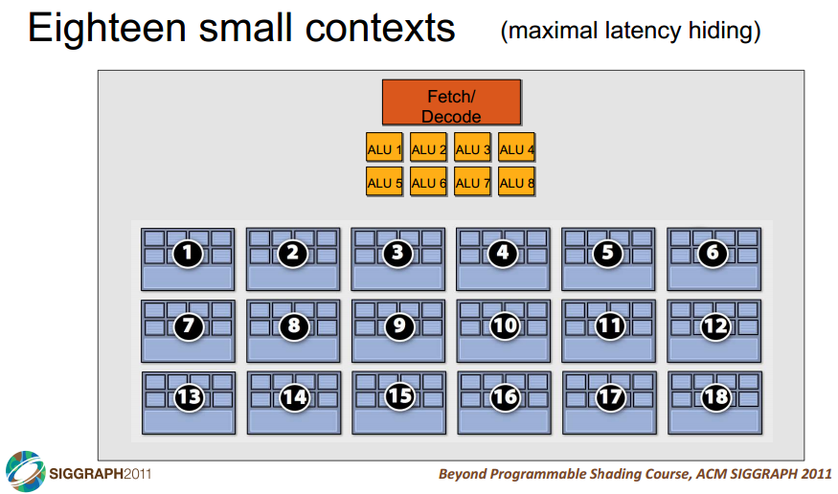

Slide 67
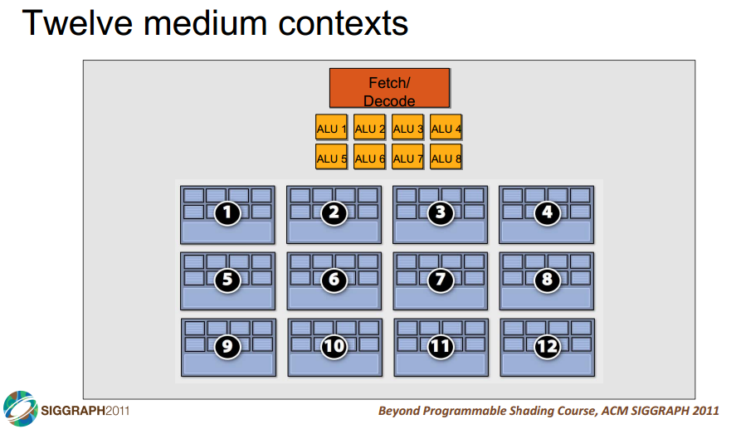

Slide 68
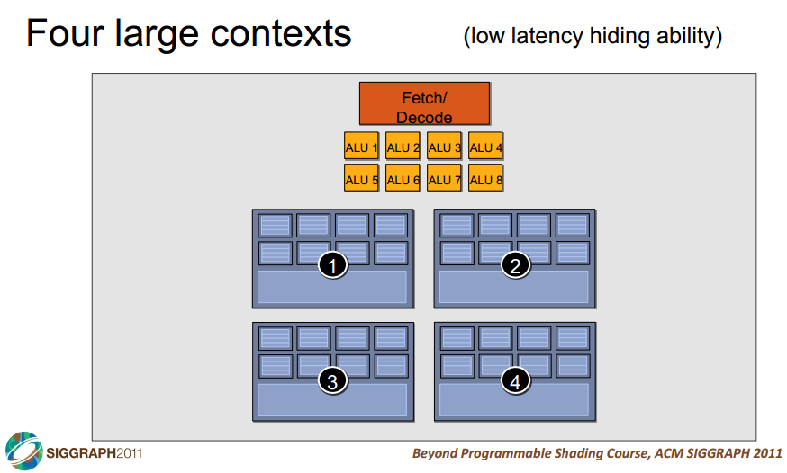

Slide 69
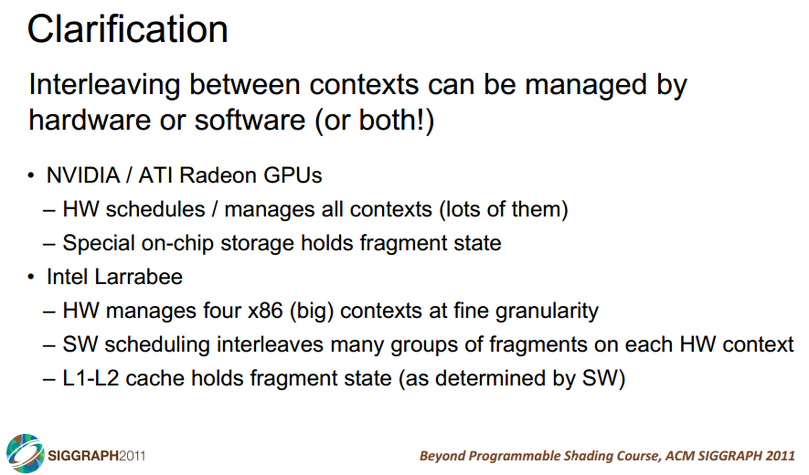

Slide 70
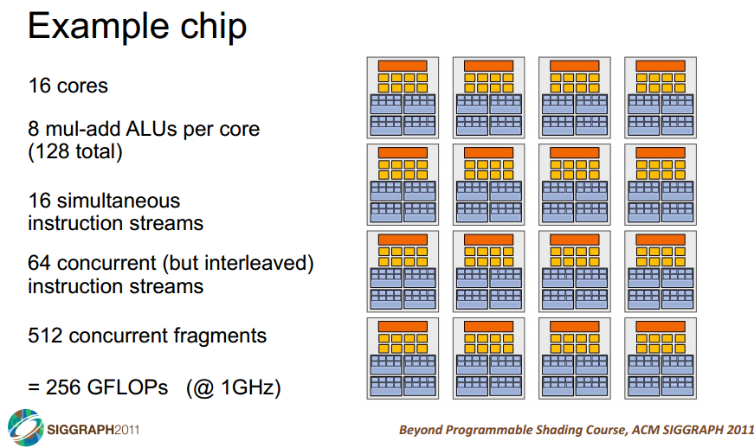

Slide 71
